Slide 1
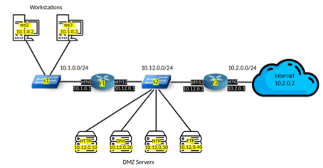

LINFO2347: Computer system security
Project 2 – network attacks
Authors:
Diego Troch
Sam Raymakers
Teaching staff:
Ramin Sadre
François Keersmaeker
Tom Rousseaux
1
16/05/2025
1

Slide 2


Attack 1 : network scanning
TCP SYN port scan and UDP port scan
Scan_defense.nft
Networkscan.py
16/05/2025

Slide 3



Attack 2 : ARP Poisoning
arp_poison.py
arp_defense.py
MAC adress ws2 : c6:ee:e1:d6:df:fb
ping 10.1.0.1
ping 10.1.0.2
MAC adress r1: e6:b4:81:40:67:bf
MAC adress r1: c6:ee:e1:d6:df:fb
16/05/2025

Slide 4



Attack 3 : FTP Brute-force
10k-most-common.txt
ftp_defense.py
ftp_bruteforce.py
every 5 seconds:
ftp.login (passwd)
If >5 login in 60 seconds
drop connections
16/05/2025

Slide 5




Attack 4 : SSH brute-force
10k-most-common.txt
ssh_defense.py
ssh_bruteforce.py
every 5 seconds:
ssh.connect(passwd)
If >5 login in 60 seconds
drop connections
16/05/2025

Slide 6



Attack 5 : Reflected DNS DoS
reflected-dos.py
reflected_dos_protect.py
Spoofed ip = 10.1.0.3
16/05/2025

